Slide 1
Booting from hard disk…
Starting Windos 98…
Start now

Slide 2


Slide 5

explorer

Slide 6
Internet explorer 22.5:

Slide 8

Welcome to Windos 98!
Welcome to setup
Close the window to start the welcome tour!

Slide 9





Welcome!
Welcome to Windos 98!
This OS features:
New, tighter security
New Internet Explorer 22.5 to provide the best browsing experience
New email client to help you manage emails better
New software to get things done!
A rock- solid filesystem makes Windos a lot less prone to crashing
Alerts tell you when your security is not optimal
Many pre installed programs that are your to keep
Sleek icons
Great internet connectivity
Easy Internet Setup®
A beautiful interface which is optimised for readability
Close window to proceed

Slide 10
This OS is under construction.
Please only use it for testing purposes.
Please click me to continue

Slide 11
Installing Windos 98…

Slide 12
Complete!
Setup has finished installing Windos 98.
Please close the window to proceed with updating Windos 98

Slide 13
Welcome!
Please set a password to use with this computer:
>

Slide 14
Security alert
Setting a blank password is dangerous and this allows anyone to access the system without your contest!
Close to proceed
Go back and set a password

Slide 15
Connecting to the Internet…

Slide 16
update
Setup is ready to install updates to Windos 98.
Please close the Window to proceed.
This cannot be skipped!

Slide 17


Slide 18
updater
Updates have been installed and Windos 98 has been installed.
Please close the window and log on.

Slide 19
You need a password!
Please add one by reinstalling Windos 98!
login
Please press the button to sign in:
Sign in

Slide 20

What’s new:
Added icons to start menu items
Added site
You may click outside of the start menu to exit it
Enhanced welcome experience
Added icons to system areas
Optimised interface
Improved Internet connection stability
Moved this widget
Removed the bin for now as the icon is blurry which makes it look ugly
This is da last alpha build
Added 2 websites
Windos 98
Alpha 3

Slide 21

Clippy is not working!
Please update to fix the issue
Shortcuts:
Computer
All Apps
Power Menu
IE225
Icon pack

Slide 22
Internet Explorer 22.5; connected; DNS 1.1.1.2; IP address 112.12.12.345; connection speed is 10mbps; up to date browser;
DNS protocol is HTTPS; internet is secured by TSL encryption; cookies enabled; 1000 cookies stored in browser; this site uses 10 cookies; Internet Explorer was made by M1cr0$0ft in 2020. the successor of 3dg3.
Welcome to the Internet!
Please select one of these sites:
Get aCCe55
Return of the Documents
News
Version plan from developer

Slide 23
computer
No readable disks inserted
Please update to see if C:\ Is added!

Slide 24
All apps
IE22.5
Email 2.02
Runtime Broker
computer

Slide 25
Email client
V2. 02
For Windos 98
© 2020 M1cr0$0ft c0rp.

Slide 26
Email client v2.01 - inbox
It is empty! :)

Slide 27
Power off
Power off
Reboot
Sign out
Sleep
Crash system

Slide 28
Crash system
Click outside of window to cancel.
Close window to accept

Slide 29
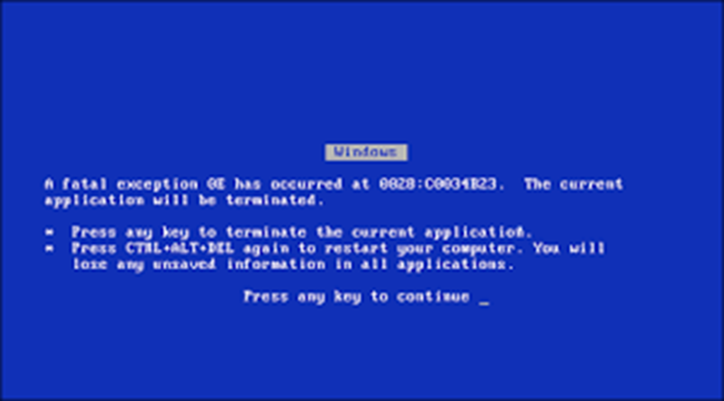

Slide 30
It is now safe to turn off this PC
Press ESC to turn off
reboot

Slide 32
Internet explorer 22.5:get aCCe55
Hey!
Click on da link 2 aCCe55 drive C if it is hidden in your version!
BTW the drive may not be 1nd3x3d s0 u m4y h4v3 2 w41t Unt1l 1t 1s Unh1dden 2 C da full d1sk!
Get aCCe55

Slide 33






explorer
C:\Windos\shell32.dll

Slide 34

explorer
C:
Windos
Username
admin
SYSTEM
windos.exe
Welcome.exe
Explorer. exe
bin

Slide 35
explorer
C:\windos
system32
winSxS
war
shell32.dll

Slide 36
Access denied!
The system does not let you access that!
This is to protect the system
Click outside to exit

Slide 37
Access denied!
The system does not let you access other user folders!
This is to protect their privacy!
Would you like it if someone looked at your documents?
Click outside to exit

Slide 38
Access denied!
The system does not let you access your user folder!
This is to prevent hackers from accessing your files
Thank us later for the security!
Click outside to exit

Slide 39
Internet explorer 22.5:
Hello!
As you probably know Windos 98 has blocked you from accessing your documents located at C:\username
Click on the link to be redirected to the folder now!
Note: in a future update this bug may be patched
Note 2: Only Windos can add in documents, as the folder is read only.
Note 3: please do not delete this folder as the system needs it
Note 4: do not try and open the system sub folder.
Note 5: you may not be allowed to access sub folders.
Note 6: I refuse to update this site if the glitch is patched
Note 7: this site may be taken down, so I will hack beta 1 so that it has the shortcut in the C:\ folder.
Windos has patched the bug before it reached consumers!
Go to C:\Username

Slide 40
Internet explorer 22.5: news
This site is under construction in a hidden part of the system!
Please update to see if it is released to you

Slide 41
Action centre:
Summary of basic actions you may need to take:
Set a password for this PC
Firewall is ON
Home network detected
OS version is unstable
Web protection OFF

Slide 42
Password protection
Hey.
You need to set a password to your system!
Please reinstall the system and set one.
How to reinstall Windos

Slide 43
Home network
Your PC is visible to devices on the network as Windos detected it as a home network.
It is a work network
It I a public network

Slide 44
Unstable OS
Hello.
This OS is not an official build.
Please install an official build if you can.
That way there will be fewer bugs and you will always be up to date.
This is Windos 98 alpha.
Please get Windos 98 v1.00 when it comes or get Windos 95.

Slide 45
Web protection
Please enable Web Protection in Internet Explorer by asking your admin to disable Trusted Network Mode in the control panel.
This will be disable by default in beta 3.

Slide 46
Internet explorer 22.5: version plan from dev
Beta 1:
An app update
Beta 2:
An internet update
Beta 3:
Background update
Beta 4:
Help update
Beta 5:
Final touches
V1. 00:
Launch update, will add more apps.

